Slide 1
FRUGAL FORCE
Ethan Emmanuel, Om Hirpara, Alaa Jalali, Andrew Tran

Slide 2
OBJECTIVE
The main goal of this project is to develop a Budget Planner tool that helps individuals manage their personal finances, track their spending habits, and become financially aware by providing real-time tracking, insightful reports and graphs, financial goal setting, and progress tracking.
Project Description:
Budget Planner tool for personal finance management and spending tracking
Users can create budget, set spending limits, and input daily transactions
Real-time spending tracking with insightful reports and graphs
Financial goal setting and progress tracking
Motivation:
Financial awareness becoming more important as we become independent
Tracking expenses, including investments, to narrow down net income
Identifying areas for cutting down on spending habits

Slide 3
COST
Estimated lines of code needed for the application: 15,000 lines
Cost per line of code is approximately $13
$13 x 15,000 = $195,000
Project Manager: Oversees the entire project, communicates with the client, and manages the development team. Average hourly rate: $150.
Software Architect: Designs the software architecture and ensures that the system is scalable and maintainable. Average hourly rate: $150.
UI/UX Designer: Designs the user interface and user experience. Average hourly rate: $100.
Front-end Developer: Develops the client-side code of the application. Average hourly rate: $125.
Back-end Developer: Develops the server-side code of the application. Average hourly rate: $150.
Quality Assurance Engineer: Tests the application for bugs and ensures that it meets the requirements. Average hourly rate: $125.
Technical Writer: Creates technical documentation for the application. Average hourly rate: $75.
Total cost: $875/hr

Slide 4
COST OF SOFTWARE
FIGMA
TRELLO
Figma professional plan
$12 per month per user
Unlimited version history
Sharing permissions
Shared and private projects
Trello standard plan
$10 per month per user
Unlimited boards
Unlimited storage (250MB/file)
1,000 Workspace command runs per month
Saved searches

Slide 5
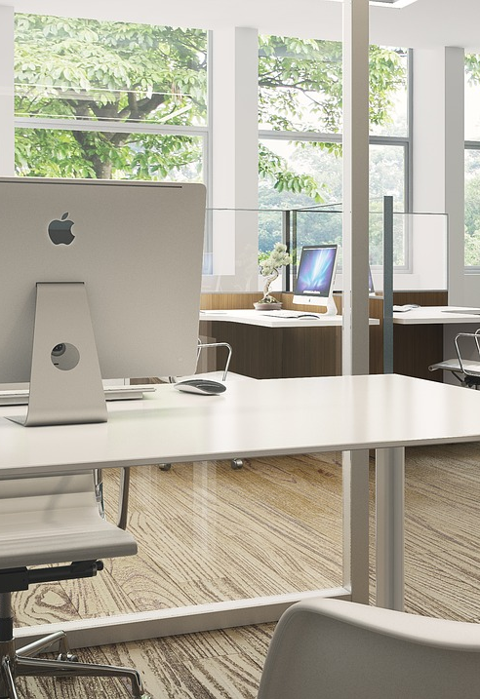
COST OF HARDWARE
Work space for development team - $1600
Desk - $200
Computer - $800
Monitor - $200 (x2) = $400
Peripherals - $100
Chair - $100
Sever Rental - $70/mo

Slide 6
TIMELINE
Project Scheduling timeline:
Start Date: 7/1/2023
End Date: 1/31/2024
Justification:
Start Date of August 1st to gather information and learn about technologies
End Date of January 31st for final rounds of major testing
Weekends are not counted in the schedule
Working hours per day: 4 hours
Final month (1/1/2024 - 1/31/2024) may have increased working hours and utilize weekends depending on integration testing schedule.

Slide 7
REQUIREMENTS
Functional requirements
An user shall be able to manually add and remove transactions from their transaction history
The system shall generate reports that can be categorized by expense type, time period, or a mix of both, on demand.
The system shall generate projections towards user-defined goals each day.
The system shall be able to import generated transaction data (in the form of .csv or .txt files) and add it to an user’s transaction history.
The system shall be able to export the user’s transaction history (in the form of .csv or .txt files).
The user shall be able to create custom filters for their transaction history (based on string matching).
Non-functional requirements
The system must be usable and accessible for all users, including those who suffer from disabilities such as blindness.
The system’s performance shall prioritize loading transaction data within 5 seconds, while graphs and reports shall be loaded within 30 seconds.
The system must not use more than 300MB of RAM. It shall prioritize loading textual data first if user storage is insufficient.
The system must be online and available 24/7. Any scheduled downtime shall not exceed 30 minutes.
The system will require two-factor authentication in addition to industry standard encryption for user accounts.
The system will be hosted on the internet.
The system will be operated by an user that creates their own account using a unique username and password.

Slide 8
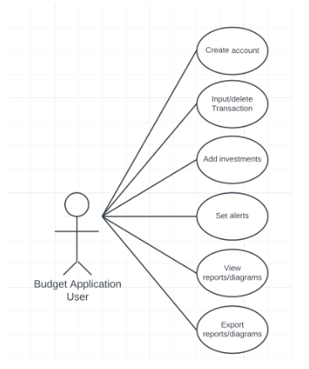
USE CASE DIAGRAM
Budget App User:
Create Account
Input/Delete Transaction
Add Investment
Set Alerts
View Reports/Diagrams
Export Report/Diagrams

Slide 9
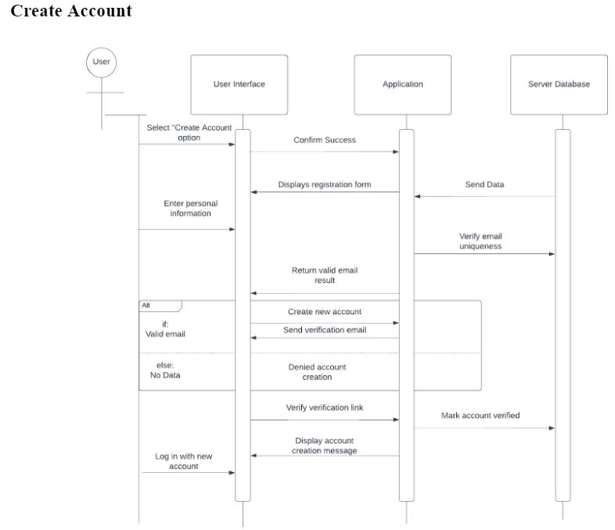
SEQUENCE DIAGRAM
USER INTERFACE
APPLICATION
SERVER DATABASE

Slide 10
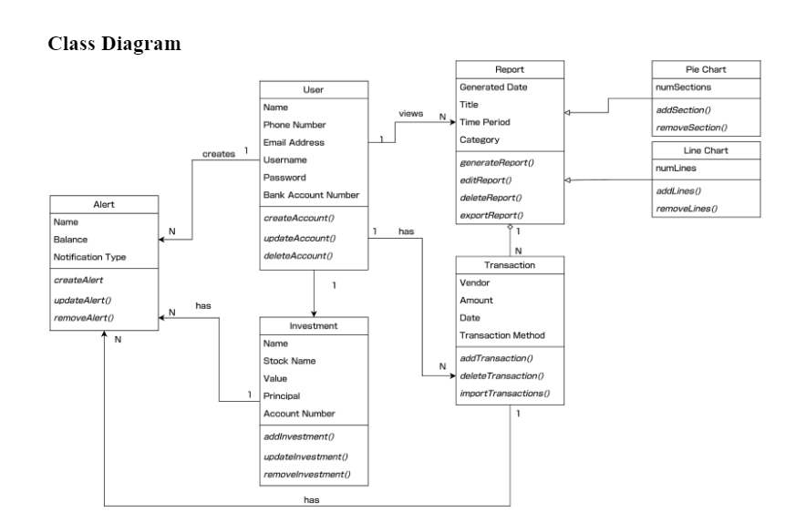
CLASS DIAGRAM
USER
REPORT
PIE CHART
LINE CHART
TRANSACTION
INVESTMENTS
ALERTS

Slide 11
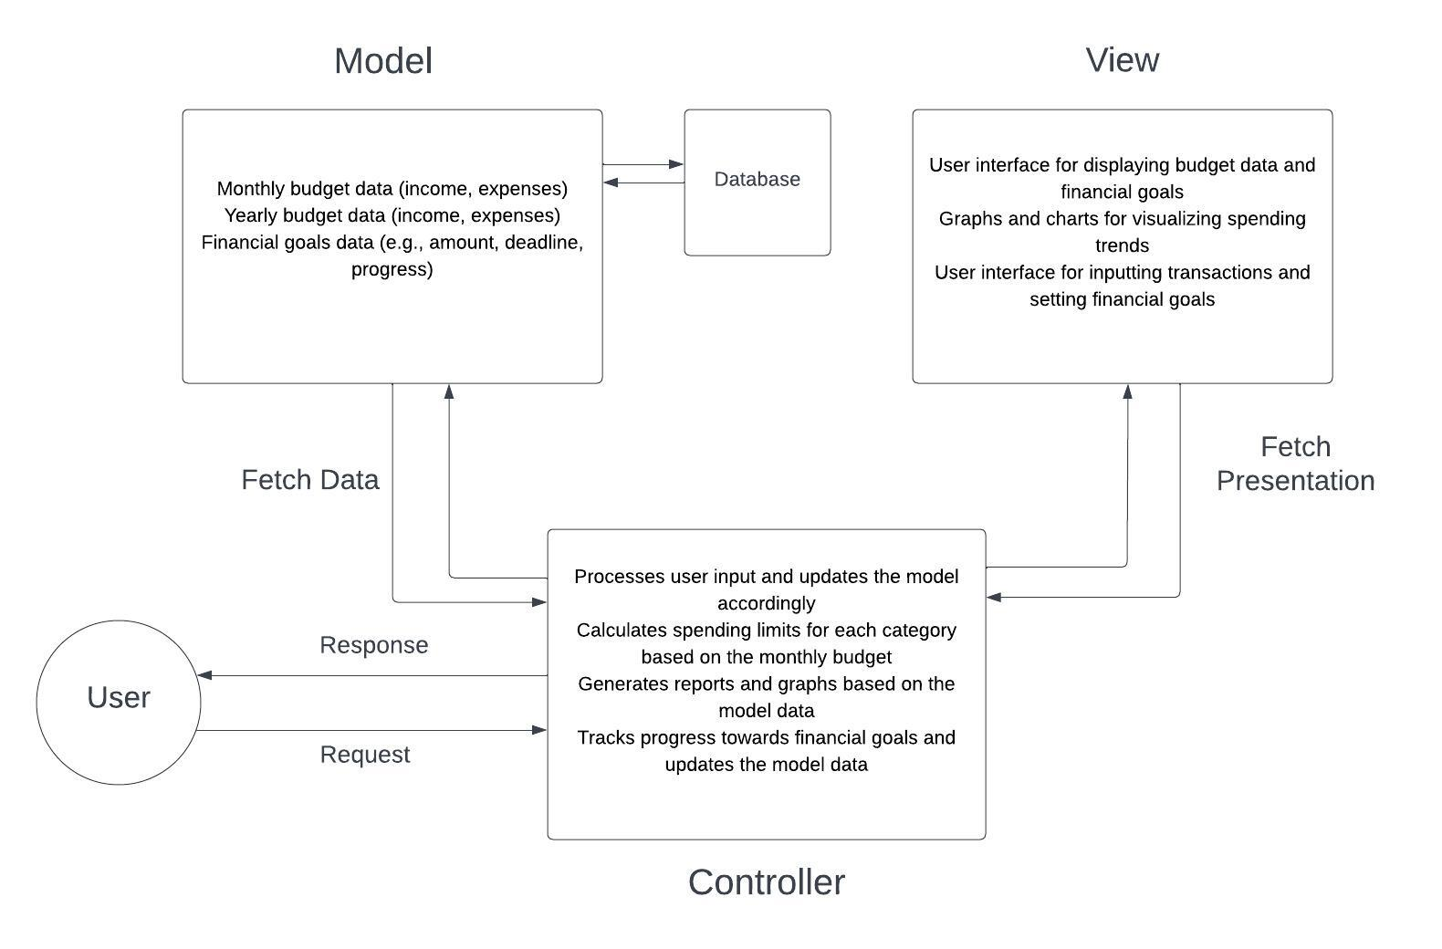
ARCHITECTURE
Our chosen software architecture model is MVC
Model component contains user's budget data (monthly and yearly)
View component renders data for user to see
Graphs and charts can show historical spending trends
Controller component contains application behavior and calculations

Slide 12
CONCLUSION
The development of a Budget Planner tool is important for personal finance management, tracking spending habits, and becoming financially aware. The tool helps individuals to create budgets, set spending limits, input daily transactions, track spending in real-time, and provide insightful reports and graphs. Moreover, users can set financial goals and track their progress towards those goals. The project's main objective is to develop such a tool that will help individuals become financially responsible, identify areas for cutting down on spending, and improve their savings, ultimately leading to a better financial future. The project is expected to be completed within the timeline of July 1, 2023, to January 31, 2024, with 4 hours of work per day and the last month reserved for final testing.

